Slide 1
Retina Project
Project team - 14 Retina

Slide 2




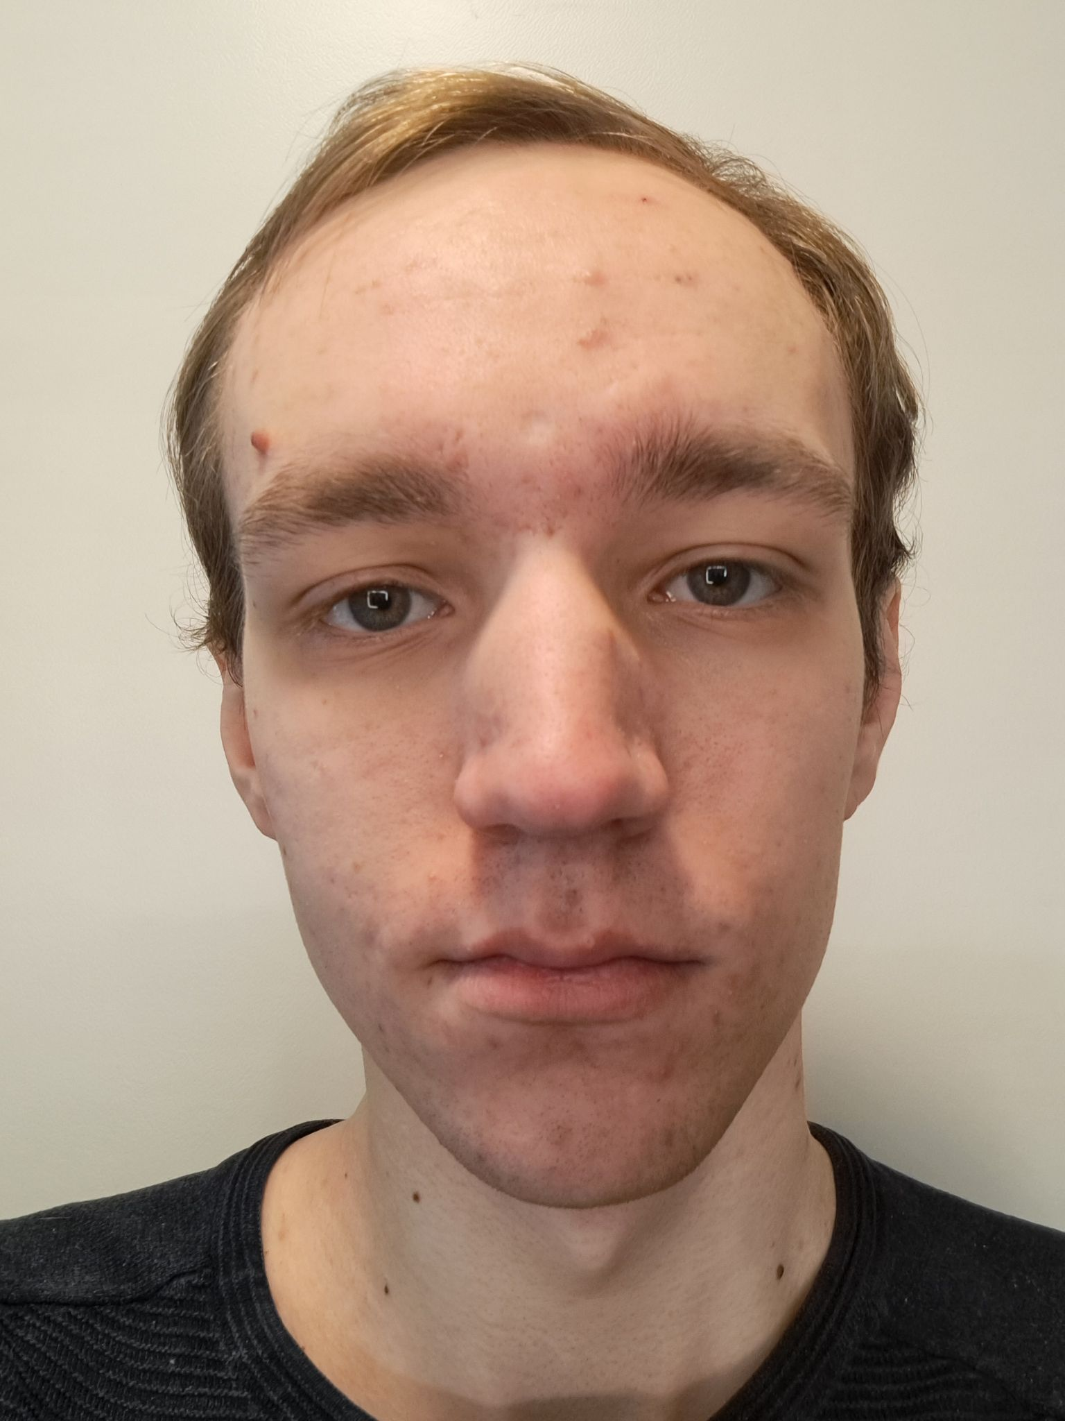
Emil Söderström
Jakob Kieri
Johan
Sundin
jakkie-1@student.ltu.se
johsuc-1@student.ltu.se
Vithun Natesh Balakathiravan
vitbal-4@student.ltu.se
Toste
Junkka
tosjun-0@student.ltu.se
emisde-2@gmail.com

Slide 3
Introduction
2 SNN architectures
Direction selective
Reichhardt inspired
Data was generated by us

Slide 4
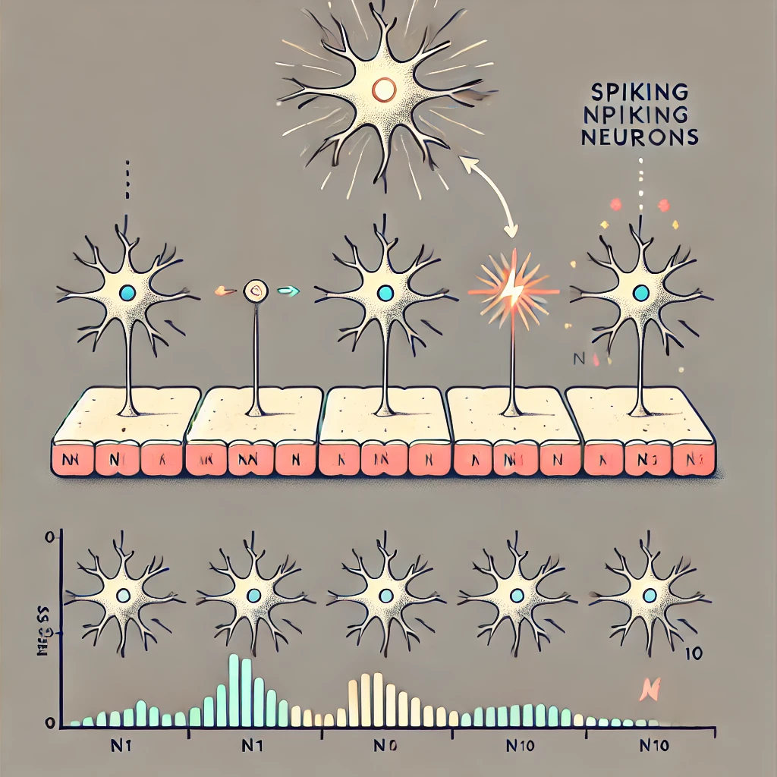
Understanding the Motion Detection System
We are simulating a system where a bright spot moves over a row of sensors (neurons)
Each sensor fires a spike when the spot passes over it
Our goal is to train a Spiking Neural Network (SNN) to recognize motion direction based on these spikes

Slide 5
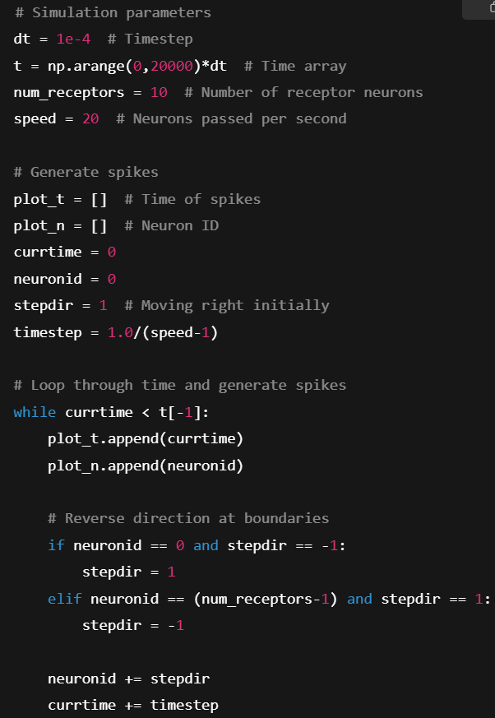
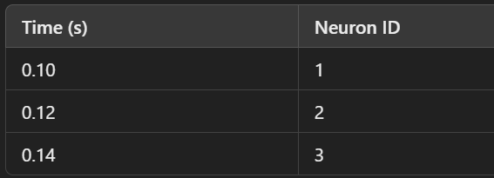
Generating Spike Data
To detect motion, we first generate spike data
Each time the bright spot moves over a neuron, that neuron fires a spike
Each spike has a timestamp and neuron ID
If the spikes happen in order (1 → 2 → 3 → 4), the motion is rightward. If reversed, it's leftward

Slide 6
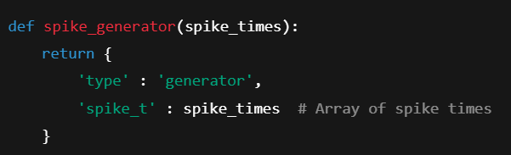
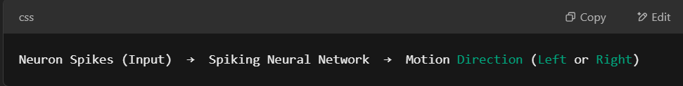
Feeding Spike Data into the SNN
We use the spike sequences as input to an SNN
The network learns motion patterns by detecting whether spikes occur in order or reverse order
The neural network does not see the bright spot directly, it only sees spikes

Slide 7
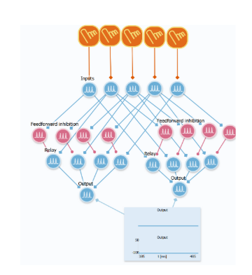
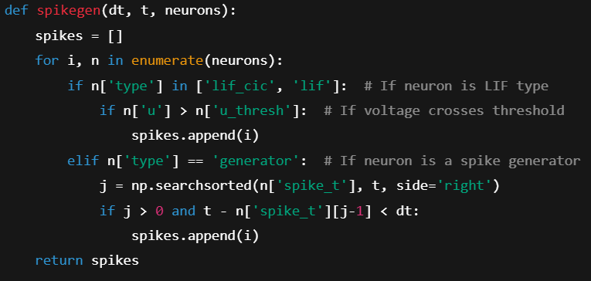
Training the SNN (Learning Motion Direction)
The network learns using Spike-Timing-Dependent Plasticity (STDP)
If neurons fire in the correct order, their connections get stronger
If they fire incorrectly, the connections weaken

Slide 8
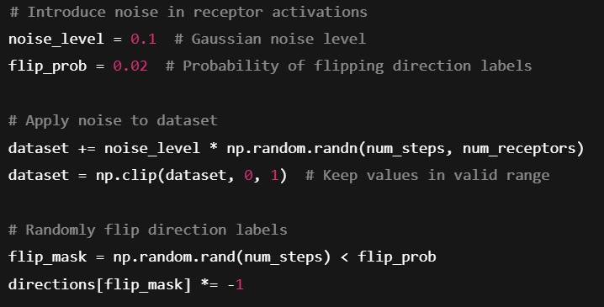
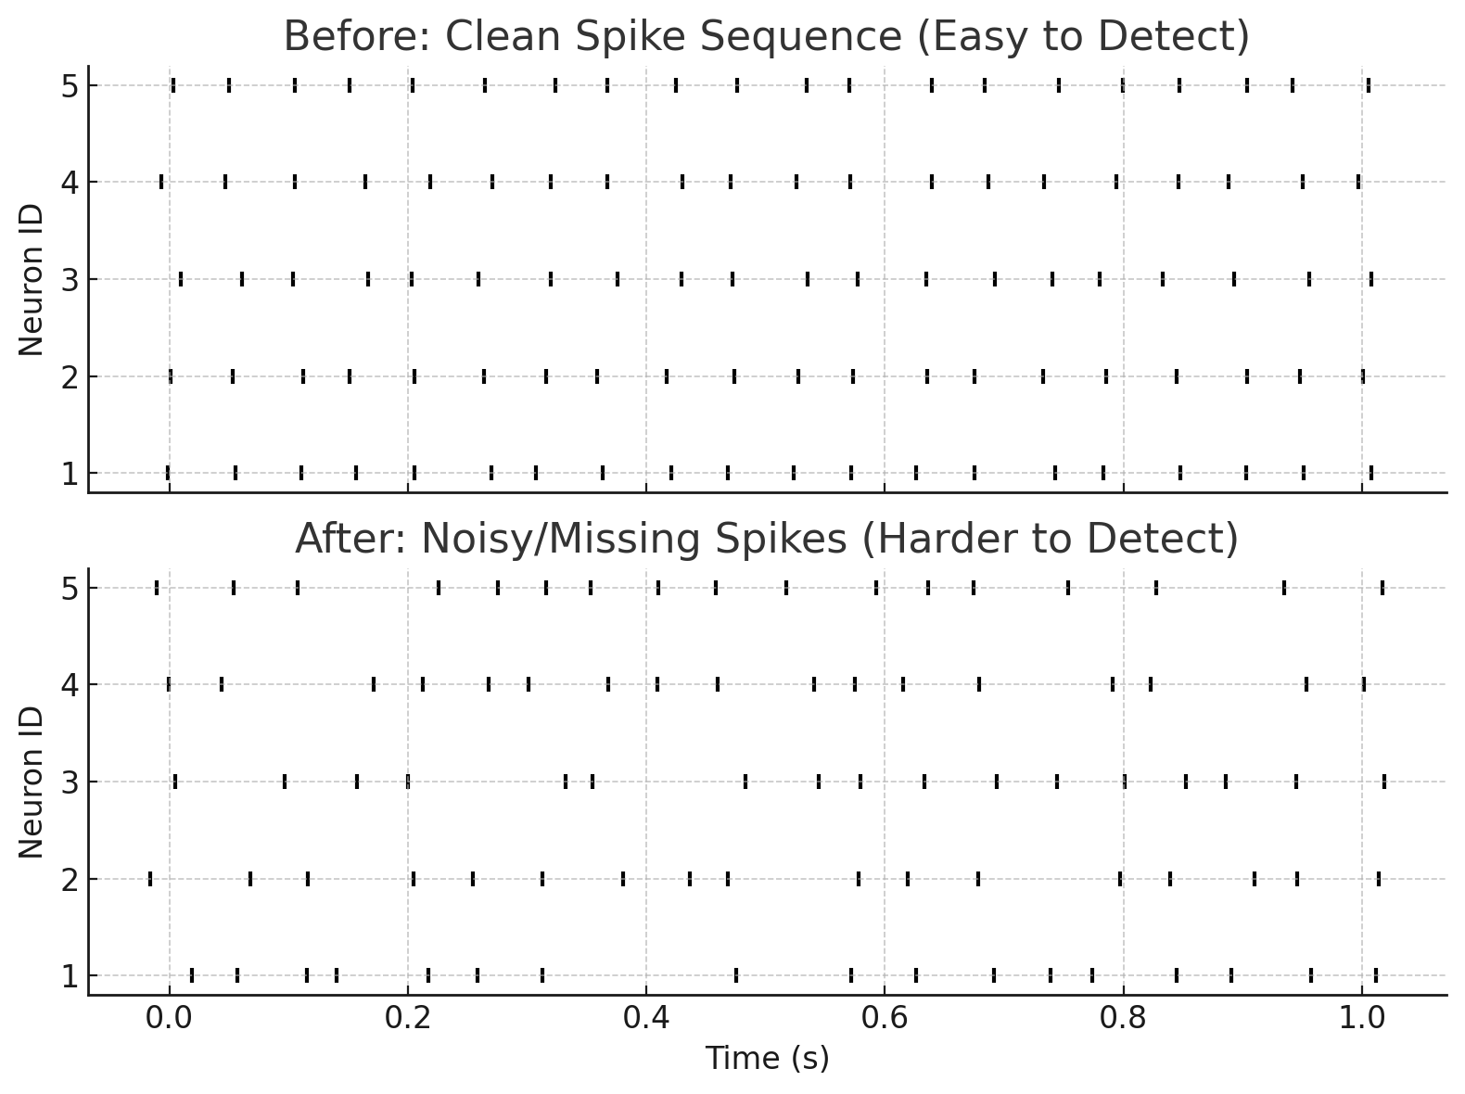
Testing & Adding Noise
Once trained, we test the network with new spike sequences
To make the test realistic, we add noise, random errors in the spike data to see if the network can still recognize motion
By training the SNN with both clean and noisy data, we ensure that it learns to generalize, meaning it can still detect motion even in less-than-perfect conditions

Slide 9
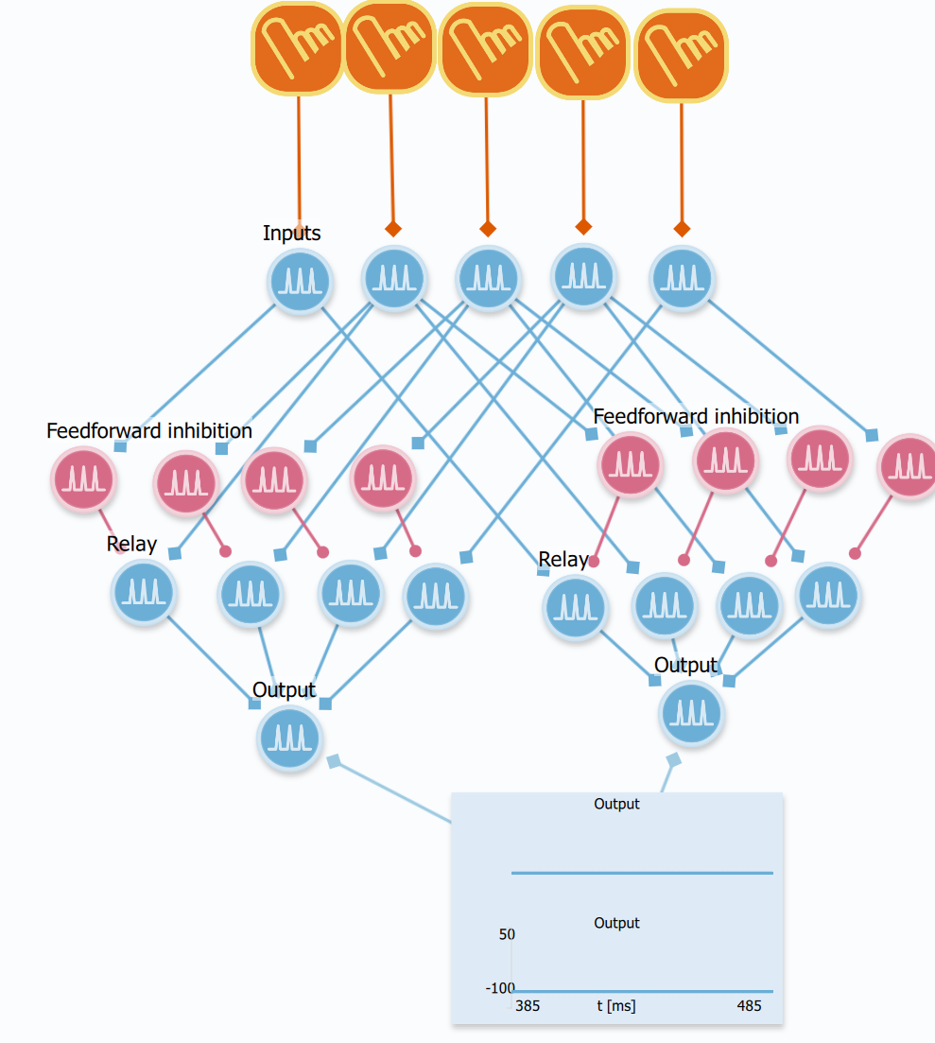
Issues Encountered
Does not handle higher speeds well.
Does not handle repeating well

Slide 10
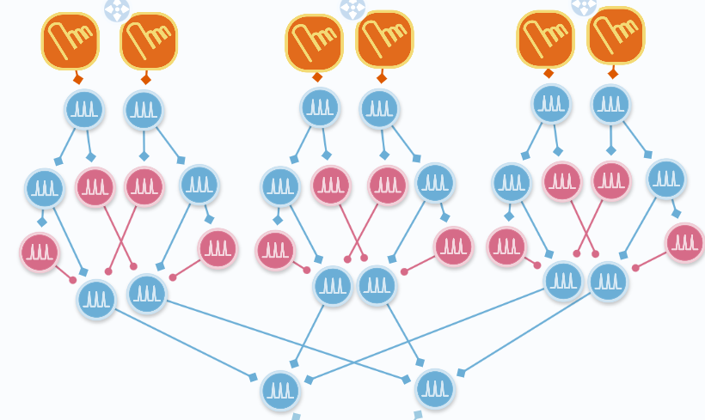
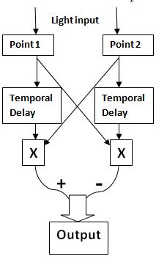
Architecture
Inspired by Reichardt model
Delay neurons
Lateral inhibition
Inhibit repetition
https://en.wikipedia.org/wiki/Motion_perception#The_Reichardt-Hassenstein_model

Slide 11
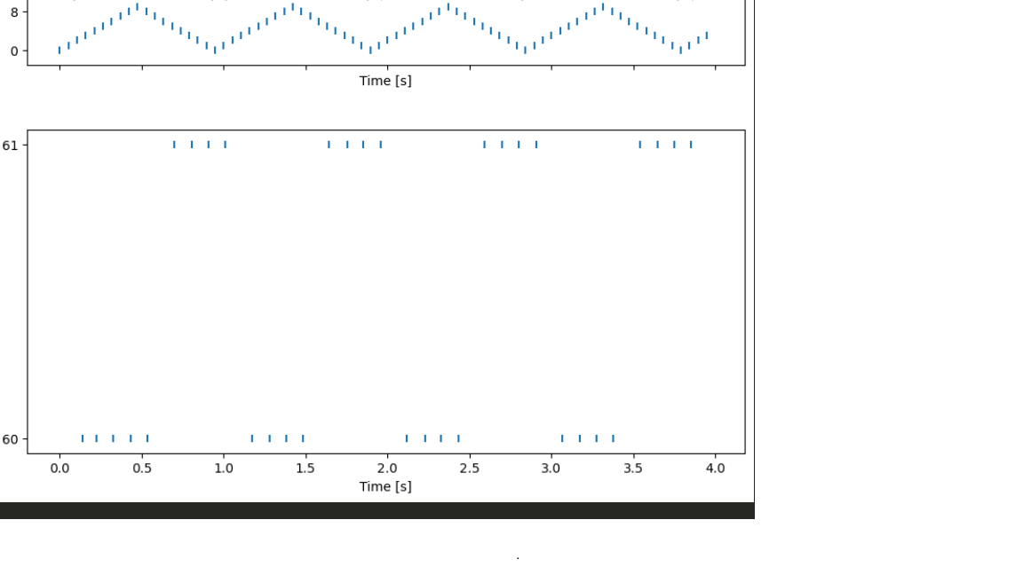
Results
Bottom spikes left to right
Upper spikes right to left
Slow response

Slide 12
Discussion
Slow response to detection because of delay nodes

Slide 13
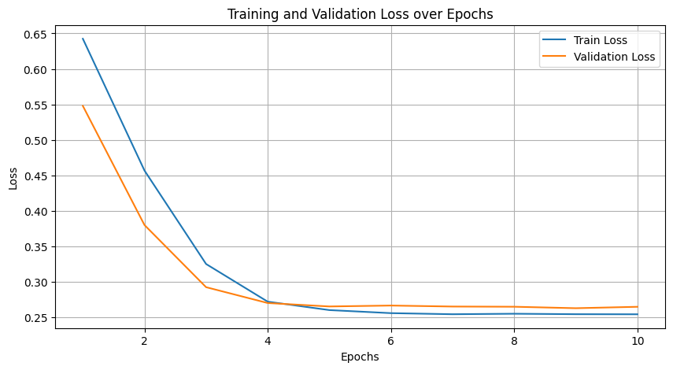
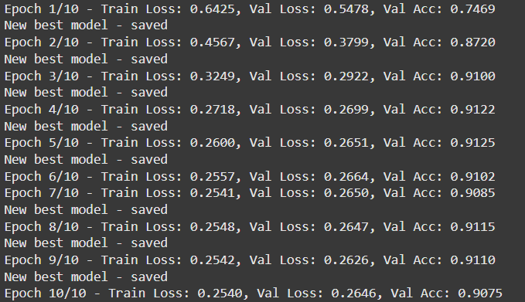
Training of a spiking neural network
Generating own dataset with and without noise
Defining the structure of the SNN
Training the model
Testing the best version
Notes:
Generates dataset of bouncing over 10 receptors.
One sample / input for the SNN is 2 frames of the dataset, that is 20 inputs.
2% probability of a flip in direction label.
Slight gaussian noise the the receptor levels, not just 0 or 1. This mimics sensor noise. (normal distribution * noise level)
60-20-20 split
Surrogate gradient for backprop. (Smooth approximation of the spike function)
Trained with adam optimizer and binary cross-entropy with logits loss, as loss function.
Fully connected three layer Leaky integrate and fire neurons (LIF).
Single membrane potential output for binary classification.

Slide 14

CONCLUSION

